Slide 1
BCB 503 Geospatial analysis workshop Introduction and concepts Spring 2020

Slide 2
BCB503 Geospatial Workshop
erichs@uidaho.edu
208.310.2140
WElcome
Overview
Welcome to the quarantine zone!
Instructor Introductions
Zoom technical issues and setup
Logistics and schedule for next two days
Get to know each other exercise

Slide 3
BCB503 Geospatial Workshop
erichs@uidaho.edu
208.310.2140
WElcome
Overview
Relax and let’s have fun! We aren’t testing you. This is about gaining knowledge you can use as a scientist.
Be respectful, professional and kind. No inappropriate language or visuals.

Slide 4
Additional preparations
BCB503 Geospatial Workshop
R and RStudio should be installed, with appropriate libraries
Able to follow along with lessons from class web site (using a web browser)
https://erichseamon.github.io/2020-03-26-uidaho-geospatial/
We will walk thru downloading data, but if you already have done that, great!
**Be prepared for technical snafus. It’s going to happen. Let’s try to roll with it.**

Slide 5
Introduction to Raster data
1. Intro to Geospatial Concepts - Raster
Raster vs. Vector data
Why do we store data in a raster format? Pros and cons
Continuous vs. Categorical rater data. What is classification

Slide 6
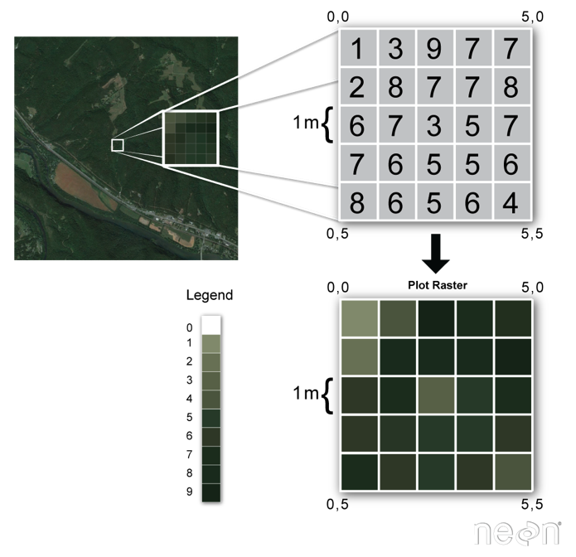
Introduction to Raster data
1. Intro to Geospatial Concepts - Raster
The two primary types of geospatial data are raster and vector data.
Raster data is stored as a grid of values which are rendered on a map as pixels. Each pixel value represents an area on the Earth’s surface.
Vector data structures represent specific features on the Earth’s surface and assign attributes to those features.

Slide 7
Introduction to Raster data
1. Intro to Geospatial Concepts - Raster
Raster data is any pixelated (or gridded) data where each pixel is associated with a specific geographical location.
The value of a pixel can be continuous (e.g. elevation) or categorical (e.g. land use).

Slide 8
Introduction to Raster data
1. Intro to Geospatial Concepts - Raster
A geospatial raster is only different from a digital photo in that it is accompanied by spatial information that connects the data to a particular location.
This includes the raster’s extent and cell size, the number of rows and columns, its projection and coordinate reference system (or CRS).

Slide 9
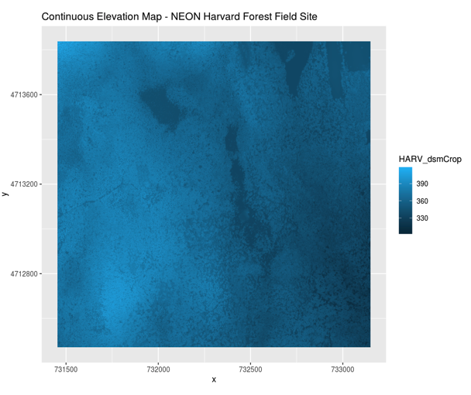
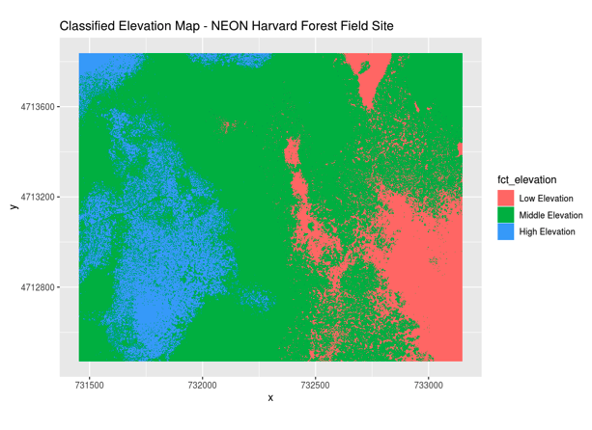
Continuous vs categorical
1. Intro to Geospatial Concepts - Raster

Slide 10
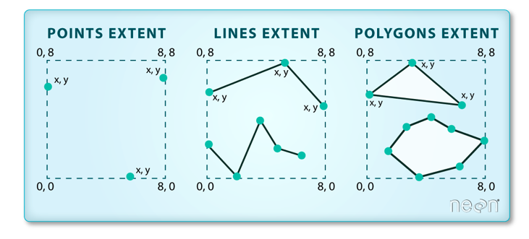
Important aspects to rasters
1. Intro to Geospatial Concepts - Raster
Spatial extent
Resolution
We will focus on spatial resolution, but there are other forms of resolution, including spectral, temporal, and radiometric

Slide 11
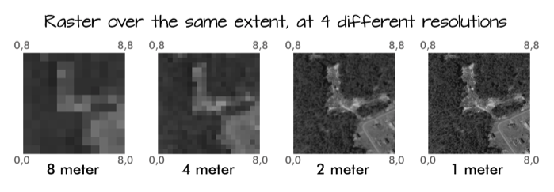
Important aspects to rasters
1. Intro to Geospatial Concepts - Raster
Spatial extent
Resolution
We will focus on spatial resolution, but there are other forms of resolution, including spectral, temporal, and radiometric

Slide 12
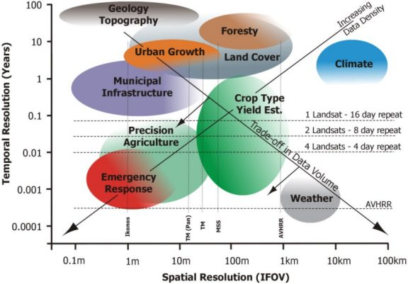
Important aspects to rasters
1. Intro to Geospatial Concepts - Raster
Spatial extent
Resolution
We will focus on spatial resolution, but there are other forms of resolution, including spectral, temporal, and radiometric

Slide 13
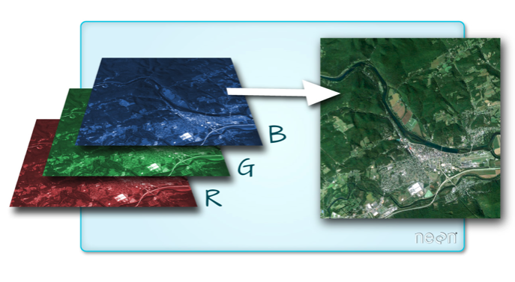
Multi-band/multi-spectral data
1. Intro to Geospatial Concepts - Raster
A raster can contain one or more bands.
One type of multi-band raster dataset that is familiar to many of us is a color image.
A basic color image consists of three bands: red, green, and blue. Each band represents light reflected from the red, green or blue portions of the electromagnetic spectrum.

Slide 14
Multi-band/multi-spectral data
1. Intro to Geospatial Concepts - Raster
A raster can contain one or more bands.
One type of multi-band raster dataset that is familiar to many of us is a color image.
A basic color image consists of three bands: red, green, and blue. Each band represents light reflected from the red, green or blue portions of the electromagnetic spectrum.

Slide 15
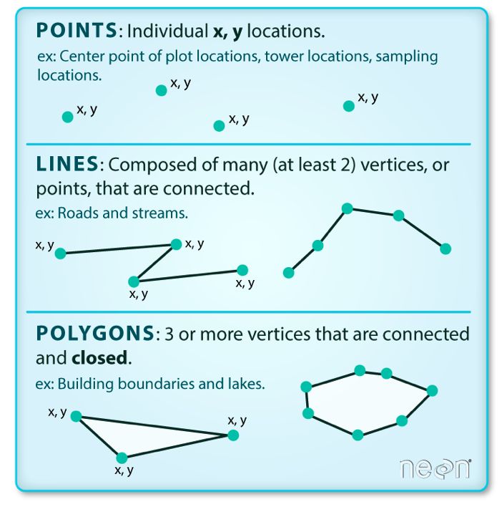
Intro to vector data
2. Intro to Geospatial Concepts - Vector
Vector data structures represent specific features on the Earth’s surface, and assign attributes to those features.
Vectors are composed of discrete geometric locations (x, y values) known as vertices that define the shape of the spatial object.
The organization of the vertices determines the type of vector that we are working with: point, line or polygon.

Slide 16
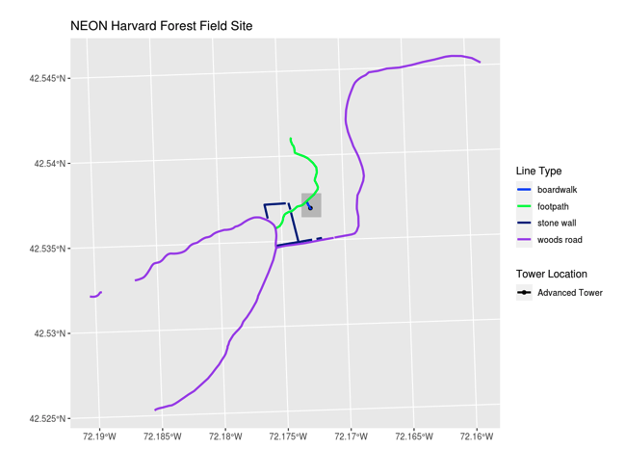
Intro to vector data
2. Intro to Geospatial Concepts - Vector
Vector data has some important advantages:
The geometry itself contains information about what the dataset creator thought was important
Each geometry feature can carry multiple attributes instead of just one, e.g. a database of cities can have attributes for name, country, population, etc.
Data storage can be very efficient compared to rasters

Slide 17
Intro to vector data
2. Intro to Geospatial Concepts - Vector
The downsides of vector data include:
potential loss of detail compared to raster
potential bias in datasets - what didn’t get recorded?
Calculations involving multiple vector layers need to do math on the geometry as well as the attributes, so can be slow compared to raster math.

Slide 18
Intro to vector data
2. Intro to Geospatial Concepts - Vector
Like raster data, vector data can also come in many different formats. For this workshop, we will use the Shapefile format which has the extension .shp. A .shp file stores the geographic coordinates of each vertice in the vector, as well as metadata including:
Extent, Object type, and the Coordinate reference system (CRS), and Other attributes: for example, a line shapefile that contains the locations of streams, might contain the name of each stream.
Shapefiles are an atomic collection (multiple files)

Slide 19
Coordinate Reference Systems
3. Intro to Geospatial Concepts - CRS
The CRS associated with a dataset tells your mapping software (for example R) where the raster/vector is located in geographic space.
It also tells the mapping software what method (projection) should be used to flatten or project the raster in geographic space.
Key components of a CRS are:
Datum – a model of the shape of the earth (ex. WGS84, NAD83)
Projection – mathematical transform of angular measurements from spheroidal to flat. May include a zonal information if UTM
Ellipsoid - mathematical surface obtained by revolving an ellipse about the earth’s polar axis. Selected to give a good fit to the geoid

Slide 20
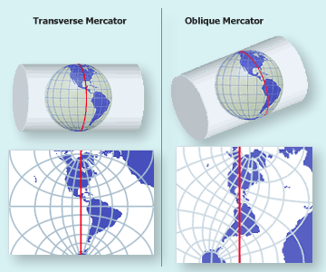
Coordinate Reference Systems
3. Intro to Geospatial Concepts - CRS
Map Projections: to convert geodetic positions of a portion of the earth’s surface to plane rectangular coordinates, points are projected mathematically from the ellipsoid to some imaginary developable surface - plane that can be rolled out flat
Coordinate Reference Systems: quantitative coordinate systems - based on mathematical projection models, often a cartesian coordinate system (i.e. x, y axes) representing relative positions within a particular map projection

Slide 21
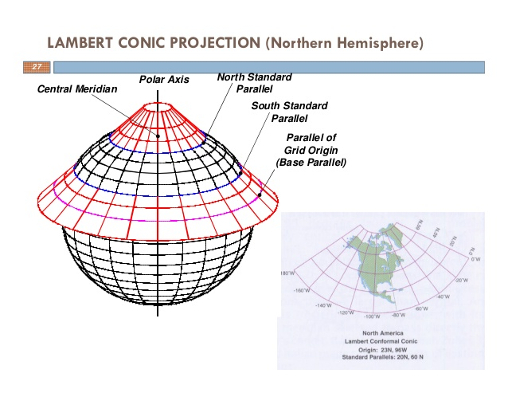
Coordinate Reference Systems
3. Intro to Geospatial Concepts - CRS
Map Projections: to convert geodetic positions of a portion of the earth’s surface to plane rectangular coordinates, points are projected mathematically from the ellipsoid to some imaginary developable surface - plane that can be rolled out flat
Coordinate Reference Systems: quantitative coordinate systems - based on mathematical projection models, often a cartesian coordinate system (i.e. x, y axes) representing relative positions within a particular map projection

Slide 22
Coordinate Reference Systems
3. Intro to Geospatial Concepts - CRS
PROJ is an open-source library for storing, representing and transforming CRS information. PROJ.5 has been recently released, but PROJ.4 was in use for 25 years so you will still mostly see PROJ referred to as PROJ.4. PROJ represents CRS information as a text string of key-value pairs, which makes it easy to customise (and with a little practice, easy to read and interpret).
A PROJ4 string includes the following information:
proj=: the projection of the data
zone=: the zone of the data (this is specific to the UTM projection)
datum=: the datum use
units=: the units for the coordinates of the data
ellps=: the ellipsoid (how the earth’s roundness is calculated) for the data
Note that the zone is unique to the UTM projection. Not all CRSs will have a zone.

Slide 23
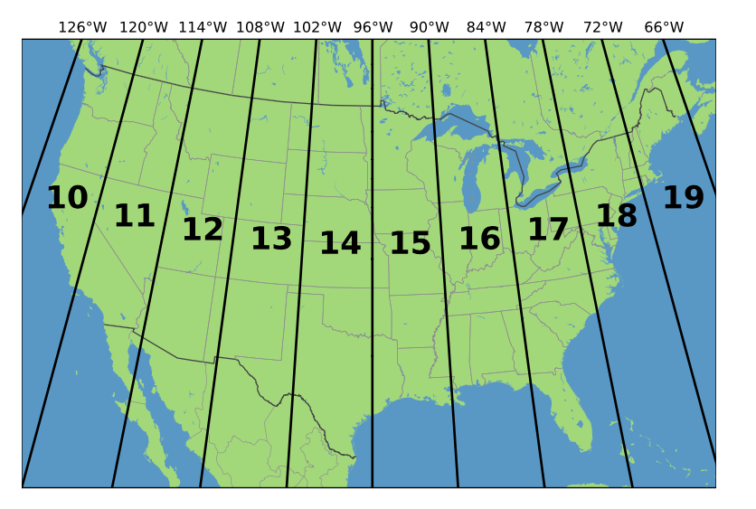
Coordinate Reference Systems
3. Intro to Geospatial Concepts - CRS
UTM Zones
+proj=utm +zone=18 +datum=WGS84 +units=m +no_defs +ellps=WGS84 +towgs84=0,0,0

Slide 24
Coordinate Reference Systems
3. Intro to Geospatial Concepts - CRS
+proj=utm +zone=18 +datum=WGS84 +units=m +no_defs +ellps=WGS84 +towgs84=0,0,0

Slide 25

Coordinate Reference Systems
3. Intro to Geospatial Concepts - CRS
GDAL is a set of software tools that translate between almost any geospatial format in common use today (and some not so common ones).
GDAL also contains tools for editing and manipulating both raster and vector files, including reprojecting data to different CRSs.
http://gdal.org

Slide 26
GEOSPATIAL LANDSCAPE
4. Intro to Geospatial Concepts – Geospatial Landscape
Commercial
Open source
ESRI
MAPINFO
Manifold
Smallworld
QGIS
GRASS
GDAL
PostGIS/Postgres
Cloud
Google Earth Engine
ArcGIS Online

Slide 27
GEOSPATIAL LANDSCAPE
4. Intro to Geospatial Concepts – Geospatial Landscape
Geospatial Libraries: R: sf, sp, gdal, spplot, leaflet, spacetime, ncdf4
Geospatial Libraries: Python: shapely, geopandas, rasterio, gdal, rasterstats
Modeling: R: caret, mlr
Modeling: Python: tensorflow, keras, sci-kit learn, numpy/scipy, Pytorch
Visualization: R: ggplot2, ggpubr, seaborn, plotly
Visualization: Python: matplotlib
https://cran.r-project.org/web/views/Spatial.html

